Slide 1
Customer Needs Analysis Understanding the Business Problem
AthenaGenAI
Client: TechFlow Solutions Industry: IT Services Company Size: 50-100 employees

Slide 2
Executive Summary
AthenaGenAI
TechFlow Solutions, a growing IT services provider, faces a significant operational bottleneck due to the manual handling of customer data and invoices. With the business expanding and the client base diversifying, the current processes for recording, validating, and consolidating information from customer forms, emails, and invoices have become increasingly unsustainable. The lack of automation not only increases administrative overhead and the risk of human error, but also limits the company’s ability to scale, respond quickly to client requests, and maintain data integrity.
Our analysis indicates that introducing a tailored, semi-automated data management solution—designed with human oversight at each critical step—will enable TechFlow Solutions to achieve greater operational efficiency, reduce costs, and unlock new opportunities for data-driven decision-making.

Slide 3
Detailed Assessment of the Current Situation a. Manual Data Capture from Multiple Channels
AthenaGenAI
Customer information is currently collected via web forms and email inquiries.
Invoices (received as PDF or HTML attachments via email) must be manually reviewed and entered into company records.
Staff are required to repeatedly enter, validate, and update data across multiple systems (e.g., Excel, Google Sheets), which increases the potential for inconsistencies and delays.

Slide 4
Detailed Assessment of the Current Situation b. Risk Factors and Pain Points
AthenaGenAI
High error rate due to manual transcription, especially when dealing with Greek names, multiple currencies, or detailed invoice line items.
Time-consuming operations that divert personnel from higher-value activities (e.g., customer support, business development).
Fragmented data storage leads to difficulties in tracking customer requests, invoice status, and service delivery metrics.
Limited real-time visibility for management, impeding timely decision-making and reporting.

Slide 5
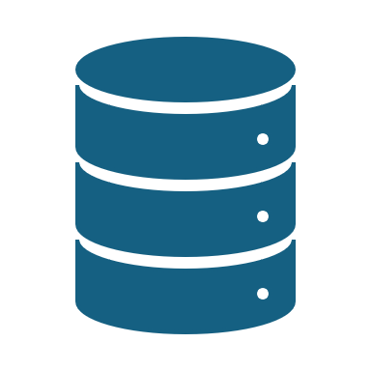
Detailed Assessment of the Current Situation c. Specific Data Processing Needs
AthenaGenAI
Extraction of structured data (name, email, phone, company, requested service, date) from diverse form formats (HTML).
Parsing and classification of incoming emails: distinguishing between customer inquiries and invoice notifications.
Automated extraction of financial information from invoices, including invoice number, date, customer, net/gross amount, and VAT.
Centralized, searchable storage of all extracted data for operational reporting and compliance.

Slide 6
AthenaGenAI
Detailed Assessment of the Current Situation d. Scalability and Compliance Concerns
As TechFlow Solutions scales up its client onboarding and billing activities, the current approach will not suffice to ensure data integrity and service reliability.
Manual data handling increases GDPR and audit risks, particularly when customer records are stored in inconsistent or decentralized formats.

Slide 7
3. Desired State & Key Requirements
AthenaGenAI
Automated data extraction from all major sources (forms, emails, invoices), minimizing the need for manual entry.
Human-in-the-loop workflow: The system must present each new entry for human review, with clear options to approve, edit, or reject data before final storage.
Centralized dashboard: Real-time monitoring of all data processing stages, including status tracking, error/warning alerts, and manual intervention capabilities.
Seamless integration with Google Sheets or Microsoft Excel for further data processing, reporting, and backup.
Full audit trail and robust error logging to ensure transparency and compliance.

Slide 8
4. Opportunities for Improvement & Value Creation
AthenaGenAI
Increased productivity: By reducing repetitive manual tasks, staff can focus on higher-impact work, improving service quality and client satisfaction.
Enhanced data quality and reliability: Automated extraction and validation reduces human error, ensuring data consistency and accuracy.
Scalability: The solution provides a robust foundation for future automation and integration with other enterprise systems (e.g., CRM, ERP).
Real-time business intelligence: Management gains immediate access to consolidated and validated data, supporting agile, data-driven decision-making.

Slide 9
Recommendations for Further Enhancement
AthenaGenAI
While the immediate focus is on solving current pain points, the proposed solution can be extended to deliver additional value, such as:
Advanced analytics and KPI dashboards for proactive management.
AI-powered data extraction for unstructured or complex documents.
Automated notifications for critical business events (e.g., unpaid invoices, VIP client requests).
Multi-language support for international operations.

